Slide 1
Structural Fire Design for Buildings
Ahn, Jae-kwon
Korea Institute of Civil Engineering and Building Technology

Slide 2
Outline
Introduction to Fire Safety
Background
Fire Safety
Fire Resistance
Current Issues
Fire and Heat
Fuels & Fire Loads
Fire Behavior & Heat Transfer
Structural Fire Design in Codes and Standards
Methods of Assessing Fire Resistance
Fire-resistance Requirements in Codes and Standards
Prescriptive Method & Calculation Method in IBC
Simple Calculation Method in EUROCODE
Advanced Structural Fire Design
Background and Key Issues
Performance-based Design Process
Whole Building Behavior and the Use of Finite Element Models
Notes:
To learn the behavior & design of structural components under fire exposure
To gain an educational & comprehensive experience in the fire resistance design concept
To learn basic fire safety design issues

Slide 3
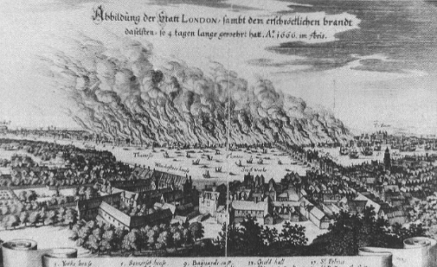
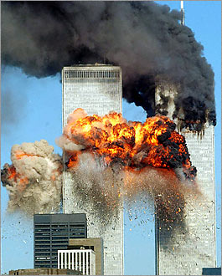
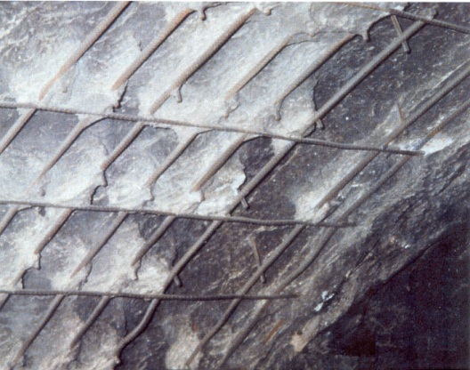
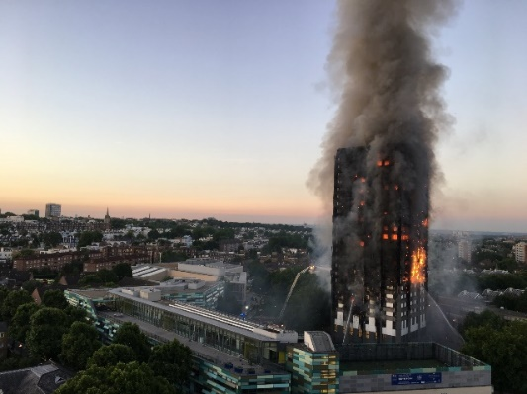
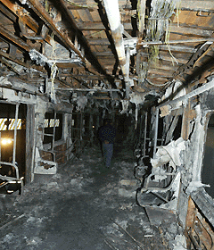
Introduction to Fire Safety
Background
Building fires cause the loss of life and damage to property.
Fire risk can be mitigated through conscientious design and maintenance.
Actually, it is impossible to prevent all major building fires.
Fire safety depends on numerous factors:
Fire prevention, suppression and extinction
Successful evacuation of occupants
Structural integrity (or robustness)
Fires
The Great Fire of London
2nd September 1666, London, UK
Within 5 days the city was destroyed by fire
440 acres consumed, 87 churches, 13200 homes
World Trade Center
11th September 2001, New York, USA
2,763 people deaths in the WTC
Fire temperatures – about 1000° C
Grenfell Tower fire
14th June 2017, London, UK
72 people deaths & 70 people injured
Exterior cladding and insulation with combustible materials

Slide 4
Introduction to Fire Safety
Role of Structures
Various occupancy
Building (commercial, industrial, residential), Outdoor stadium, Oil platform, Tower, Liquid storage tanks etc.
Provide comfortable, safe, functional space
Shelter and Support
Withstands various types of loads - Dead, Live, Wind, Flood, Snow, Earthquake, Thermal, and Fire
Fire Safety
Not possible to prevent all fire scenarios
Designers need to put in-place strategies to minimize the occurrence of fires & consequently reducing their impact on life, property and environment.
Main strategies include providing for:
Automatic fire sprinklers - statistics show that sprinklers have a very high probability of controlling or extinguishing any fire
Systems for fire detection and notification of fire service
Safe travel paths for the movement of occupants & firefighters
Barriers to control the spread of fire & smoke
Fire resistant structures - not collapse prematurely in fire
To strategize, the designer has the important responsibility to properly select, design and use building materials

Slide 5
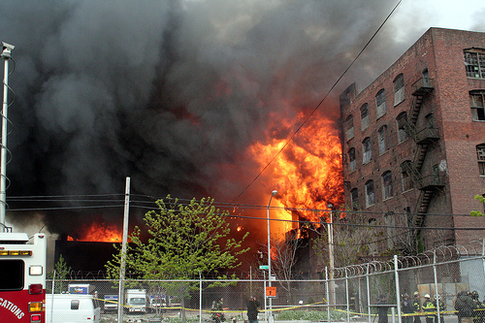
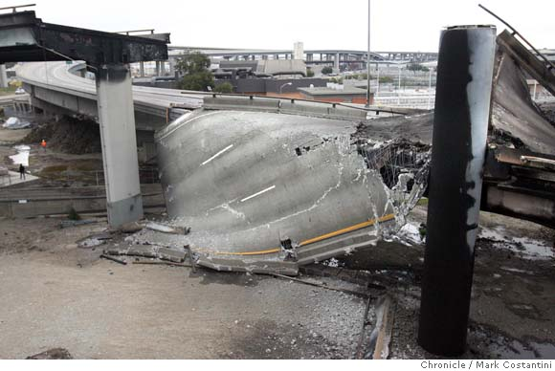
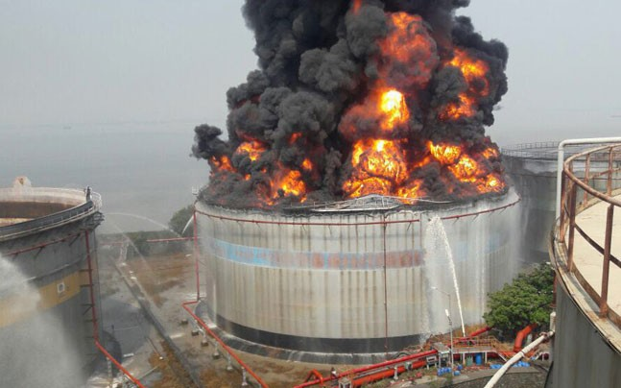
Introduction to Fire Safety
What is Fire Resistance?
Fire resistance: “the property of a material or assemblage to withstand fire or give protection from it.
Provide physical barrier to restrict fire spread
prevent fire and smoke spread
safe evacuation of occupants & firefighter
minimize life loss and injury
Maintain structural integrity and load carrying ability against fire
Minimize property damage
prevent structural collapse
Compartmentation & Structural integrity are principal aspects of fire safety in buildings
Fire Resistance Rating – Codes
The importance of fire resistance depends on the size of the building & the fire safety objectives that need to be satisfied.

Slide 6
Introduction to Fire Safety
Issue 1 - Performance-based design codes
Current approach to fire safety design: Prescriptive based approach
Significant drawbacks
Many countries including US and Europe are moving towards performance-based codes
Rational engineering approaches
Offers cost-effective, innovative & alternate designs
Performance-based design approach needs:
Validated models, test data for validation, material properties
Design tools/guidelines, trained personnel, monitoring tools
Issue 2 – New materials (High performance material)
High Strength Concrete, Fiberglass Reinforced Plastic
Benefits: Superior performance(Strength, Durability, Corrosion resistance…)
Applications: Bridges, Infrastructure projects(Retrofitting & strengthening)
High Performance Material - Plastics, Composites
Benefits: Superior strength, Light weight
Applications: Auto, Aerospace, Transportation
Major problem in fire performance
High temperature intolerant
Toxicity
Flame spread (combustible)
Faster strength/stiffness degradation

Slide 7
Fire and Heat
Fuels – Materials
Material available as fuel are part of the building structure, lining materials, or contents of the building
All materials are hydrocarbons, their molecules consisting mainly of carbon & atoms, with the addition of oxygen, nitrogen & others in some cases
Fuels – Calorific Value
Heat release rates (HRR) from combustion depend on the nature of the burning material, the size of the fire, and the amount of air available.
The calorific value or heat of combustion is the amount of heat released during complete combustion of a unit mass of fuel.
Most solid, liquid and gaseous fuels have a calorific value between 15 and 50 MJ/kg
Net calorific values of combustible materials for calculation of fire loads in EUROCODE 1
Combustible materials |  | MJ/kg
Solid | Wood | 17.5
 | Clothes, Cork, Cotton, Paper, cardboard, Silk, Straw, Wool | 20
 | Carbon: Anthracit, Charcoal, Coal | 30
Chemicals | Methane, Ethane, Propane, Butane | 50
 | Ethylene, Propylen, Butene | 45
 | Benzene, Toluene | 40
 | Methanol, Ethanol, Ethyl alcohol | 30
 | Gasoline, petroleum Diesel, Pure hydrocarbons | 45
 | Polyethylene, Polystyrene, Polypropylene | 40

Slide 8
Fire and Heat
Fire Load
Fire load in buildings is usually expressed as Fire Load Energy Density per floor area(MJ/m²).
Note that some references express fire load as energy density per total room bounding surfaces.
Design Fire Load
should be determined in a similar way to design loads
Earthquake load vs. Extreme likely design fire scenario
should reflect almost the maximum fire load expected in building life
Both fixed and moveable fire loads should be included.
Fire load densities qf,k [MJ/m²] for different occupancies in EUROCODE 1
Occupancy | Average (MJ/kg) | 80% Fractile (MJ/kg)
Dwelling | 780 | 948
Hospital | 230 | 280
Hotel | 310 | 377
Library | 1500 | 1824
Office | 420 | 511
Classroom of a school | 285 | 347
Shopping centre | 600 | 730
Theatre (cinema) | 300 | 365
Transport (public space) | 100 | 122

Slide 9
Fire and Heat
Heat Release Rate & t-squared Fires
Heat release rate (HRR)
The HRR (MW) can be calculated by the amount of heat (MJ) released in a certain time (s).
Q = E/t
E is the total energy contained in the fuel (MJ)
t is the duration of the burning (s)
t-squared fires
characterized by a parabolic curve with the HRR proportional to the time squared
Q = (t/k)² = (α t)²
Q is the HRR (MW), t is the time (s),
k is the growth constant (s/MW^{1/2}), and α is the fire intensity coefficient (MW/s²)
Fire Growth Rate | Growth Constant | Fire Intensity Coefficient | Typical Real Fire
Slow | 600 | 0.00293 | Densely packed wood products
Medium | 300 | 0.0117 | Solid wood furniture such as desk Individual furniture items with small amount of plastic
Fast | 150 | 0.0466 | Some upholstered furniture High stacked wood pallets Cartons on pallets
Ultra-fast | 75 | 0.1874 | Most upholstered furniture High stacked plastic materials Thin wood furniture such as wardrobs

Slide 10
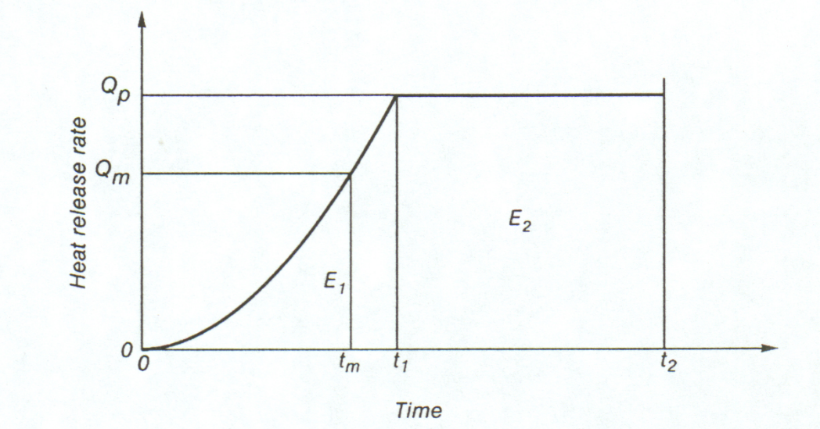
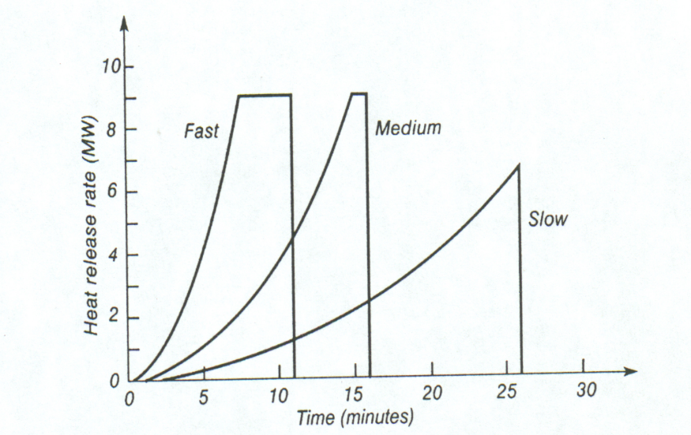
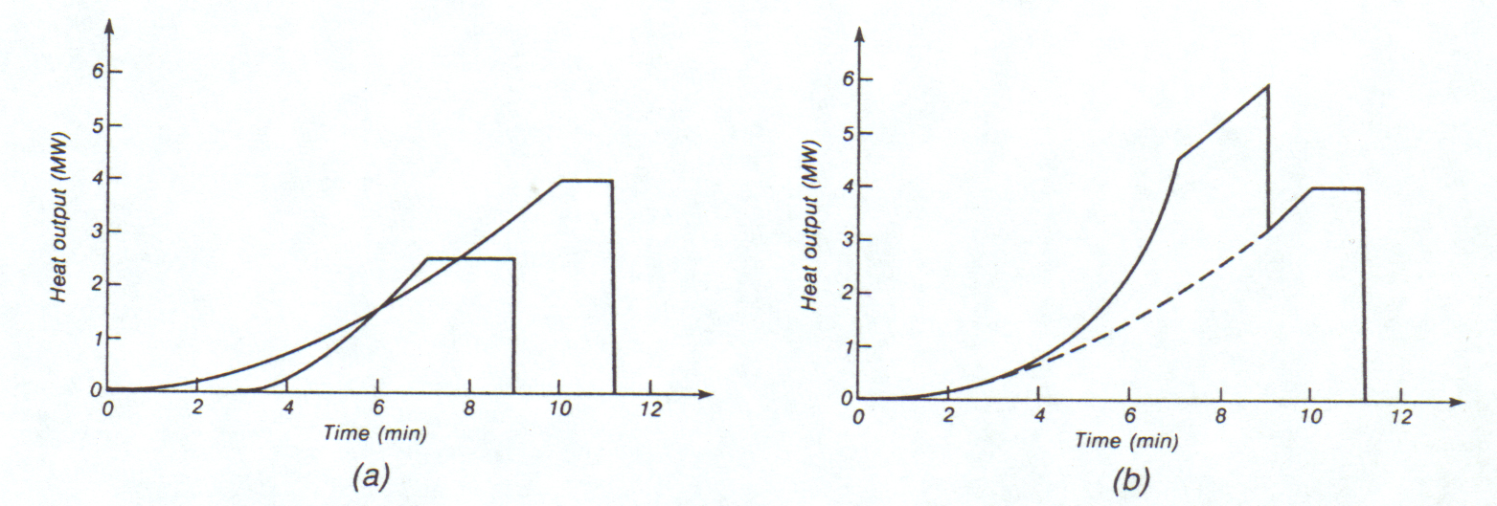
Fire and Heat
Heat Release Rate & t-squared Fires
Variation of HRR (same fire load): slow, medium and fast fire growth rates
Combination of t-squared HRRs for separately & combined for two objects

Slide 11
Fire and Heat
Fire Behavior in Building Compartment
The factors influencing the severity of a fire in a compartment are:
fire load type, density and distribution
combustion behavior of the fire load
compartment size and geometry
ventilation conditions of the compartment
thermal properties of the compartment boundary
Stages of an enclosed compartment fire
Growth phase(pre-flashover)
Flashover
Fully developed phase (post-flashover)
Decay phase
Extinction
Options for modelling compartment fires
Nominal fire
Time equivalence
Natural fire curves
Localized fires
Zone models
CFD/field models

Slide 12
Fire and Heat
Heat Transfer - Conduction
Conduction is the mechanism for heat transfer in solid materials
factor in the ignition of solid surfaces, & in the fire resistance of barriers & structural members
Thermal properties needed for heat transfer calculations in solid materials include:
density, ρ (kg/m³), specific heat, C_{p} (J/kg-K), thermal conductivity, k (W/m-K)
thermal diffusivity, α = k/ρC_{p} (m²/s), thermal inertia, kρC_{p} (W²s/m⁴K²)
Heat Transfer - Convection
Convection is heat transfer by the movement of fluids, either gases or liquids
Heat transfer by convection is an important factor in flame spread and in upward transport of smoke and hot gases to the ceiling or out of the window from a room fire
Convective heat transfer is usually taken to be directly proportional to the temp difference between 2 materials
Heat Transfer - Radiation
Radiation is the transfer of energy by waves
Very important in fires because it is the main mechanism for heat transfer from:
flames to fuel surfaces
hot smoke to building objects
a burning building to an adjacent building
Fire condition | convection coefficient (W/m²K)
Standard fires | 25
External fires | 25
Hydrocarbon fires | 50
Parametric fires | 35
Unexposed side (without & with radiation) | 4 & 9
Material | Emissivity
Carbon steel | 0.7
Stainless steel | 0.4
Concrete | 0.7
Others | 0.8

Slide 13
Structural Fire Design in Codes and Standards
Methods of Assessing Fire Resistance
The fundamental step in designing structures for fire safety is to verify that the fire resistance of the structure is greater than the severity of the fire to which the structure is exposed.
Fire resistance ≥ Fire severity
Fire resistance is a measure of the ability of the structure to resist collapse or fire spread during exposure to a fire of specified severity.
Fire severity is a measure of the destructive impact of a fire, or the forces or temp. that may cause collapse or fire spread as a result of a fire.
Methods for comparing fire severity with fire resistance
The most common verification is comparing fire severity and fire resistance in time domain.
Temperature domain is more suitable for barriers than structural elements.
Load capacity in a fire can be calculated using thermal & structural analyses at high temperature.
Prescriptive codes specify required fire resistance which is generally between half an hour and four hours, but with no reference to the severity of the expected fire
Performance-based codes allow the use of time equivalent formulae to improve on simple prescriptive fire-resistance requirements
Domain | Fire Resistance | Fire severity
Time | Time to failure | Fire duration as calculated or specified by codes
Temperature | Temperature to cause failure | Maximum temperature reached during the fire
Strength | Load capacity at elevated temperature | Applied load during the fire

Slide 14
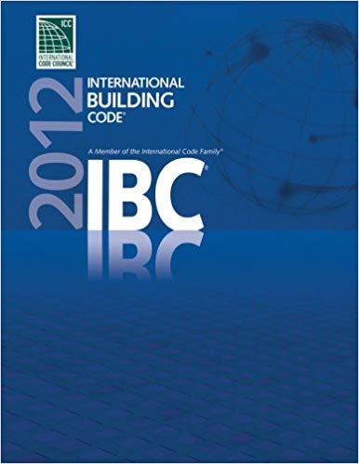

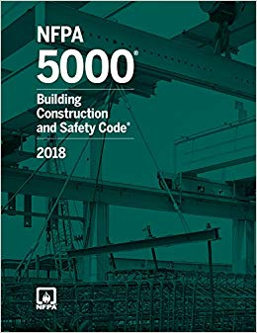
Structural Fire Design in Codes and Standards
Fire-resistance Requirements in Codes and Standards
Building codes set fire-resistance requirements for building assemblies to resist
Spread of fire within buildings
Collapse of structural elements exposed to fire
Construction type & Occupancy
Construction type
Type I & II - Non-combustible : Concrete, Masonry, Steel
Type III - Non-combustible exterior walls & Combustible/Non-combustible interior elements
Type IV - Non-combustible exterior walls & Interior elements of solid wood, laminated wood, heavy timber (HT)
Type V - allows the use of all types of materials, both noncombustible and combustible.
Occupancy
Assembly
Business
Educational
Factory & Industrial
High Hazard
Institutional
Mercantile
Residential
Storage
Utility/Miscellaneous

Slide 15
Structural Fire Design in Codes and Standards
Fire-resistance Requirements in Codes and Standards
Maximum allowable height & area of a building are determined based on
Construction type & Occupancy

Slide 16
Structural Fire Design in Codes and Standards
Fire-resistance Requirements in Codes and Standards
Fire-resistance rating requirements for building elements in IBC (hours)
Building element | TYPE Ⅰ |  | TYPE Ⅱ |  | TYPE Ⅲ |  | TYPE Ⅳ | TYPE Ⅳ
 | A | B | A | B | A | B | HT | A | B
Primary structural frame | 3 | 2 | 1 | 0 | 1 | 0 | HT | 1 | 0
Exterior bearing walls | 3 | 2 | 1 | 0 | 2 | 2 | 2 | 1 | 0
Interior bearing walls | 3 | 2 | 1 | 0 | 1 | 0 | 1/HT | 1 | 0
Floor | 2 | 2 | 1 | 0 | 1 | 0 | HT | 1 | 0
Roof | 1½ | 1 | 1 | 0 | 1 | 0 | HT | 1 | 0
Construction types in NFPA 220 (Standard on types of building construction)
3 Digit Code: e.g. 332.
1st digit: fire resistance of exterior bearing wall
2nd digit: fire resistance of columns, beams, girders, trusses and arches
3rd digit: fire resistance of floor construction

Slide 17
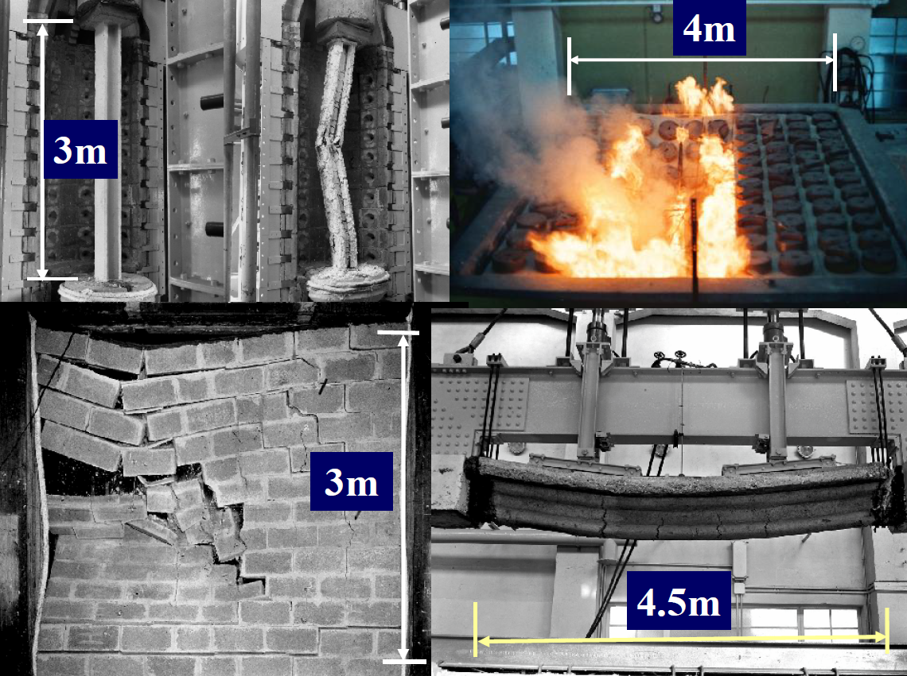
Structural Fire Design in Codes and Standards
Traditional Approaches to Structural Fire Design
Standard fire test
Most countries assess fire performance of building materials & elements using full-size fire resistance tests
Refer to results from standard test; no “engineering analysis” required
More than 100 years
ASTM E119, NFPA 251, UL 263, ISO 834, BS 476

Slide 18
Structural Fire Design in Codes and Standards
Traditional Approaches to Structural Fire Design
Code-based prescriptive design
Most codes have been prescriptive in nature for fire resistance evaluation.
Code-based prescriptive design may restrict designers to take a rational engineering approach to the provisions of fire safety
Minimum protection of structural parts based on time periods for various noncombustible insulating materials
Structural parts | Insulating material | Minimum thickness for required fire resistance time (inches)
 |  | 4 hours | 3 hours | 2 hours | 1 hour
Steel columns and all of primary trusses | Carbonate, lightweight and sand-lightweight aggregate concrete, members 6”×6” or greater | 2.5 | 2 | 1.5 | 1
 | Carbonate, lightweight and sand-lightweight aggregate concrete, members 8”×8” or greater | 2 | 1.5 | 1 | 1
 | Carbonate, lightweight and sand-lightweight aggregate concrete, members 12”×12” or greater | 1.5 | 1 | 1 | 1
 | Siliceous aggregate concrete, members 6”×6” or greater | 3 | 2 | 1.5 | 1
 | Siliceous aggregate concrete, members 8”×8” or greater | 2.5 | 2 | 1 | 1
 | Siliceous aggregate concrete, members 12”×12” or greater | 2 | 1 | 1 | 1
Webs or flanges of steel beams and girders | Carbonate, lightweight and sand-lightweight aggregate concrete with 3” or finer metal mesh placed 1” from the finished surface anchored to the top flange and providing no less than 0.025 square inch of steel area per foot in each direction | 2 | 1.5 | 1 | 1
 | Siliceous aggregate concrete and concrete excluded in Item 2-1.1 with 3" or finer metal mesh placed 1" from the finished surface anchored to the top flange and providing not less than 0.025 square inch of steel area per foot in each direction. | 2.5 | 2 | 1.5 | 1

Slide 19
Structural Fire Design in Codes and Standards
IBC - Calculation Method for Fire Resistance of Structures
includes the methods to calculate the fire-resistance rating for an assembly (concrete, concrete-masonry, clay masonry, steel and wood).

Slide 20
Structural Fire Design in Codes and Standards
IBC - Calculation Method for Fire Resistance of Structures
also contains provisions that would permit modifications or changes to a tested assembly.

Slide 21
Structural Fire Design in Codes and Standards
Structural Design in Fire Conditions
In concept, structural design for fire exposed to fire
similar to structural design for room temperature conditions
must establish clear objectives & determine design fire severity
Working stress or ultimate strength design may be carried out
Main differences between fire & ambient design are:
applied loads are less
internal forces may be induced by thermal expansion
strength of materials may be reduced by elevated temp.
cross-sectional areas may be reduced, i.e., charring
smaller safety factors used
deflections with no effect on strength are not important
different failure mechanisms need to be considered
Tools available to predict structural fire resistance of a load-bearing members include:
Hand calculations
Design charts
Computer programs

Slide 22
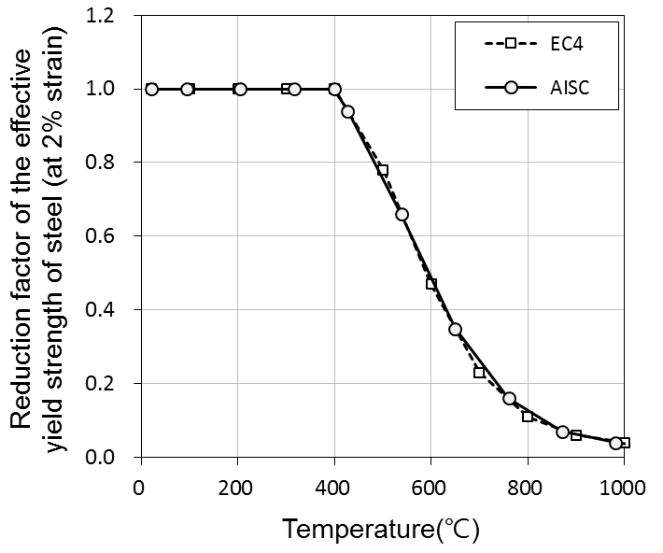
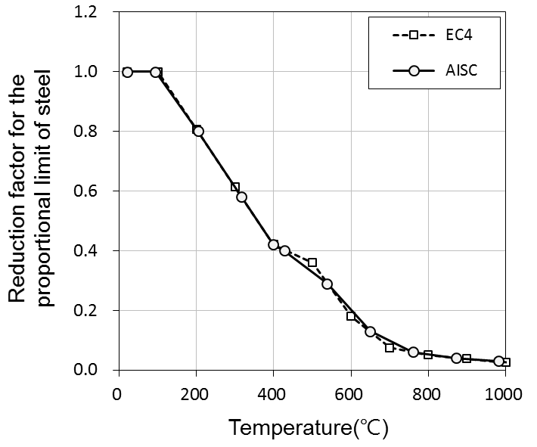
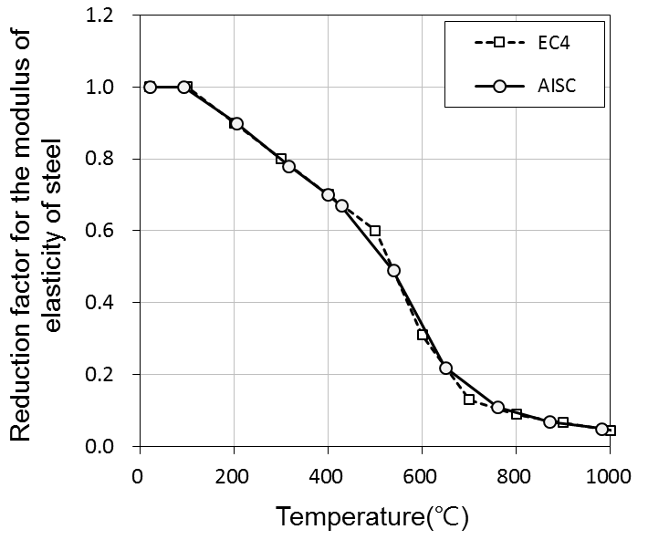
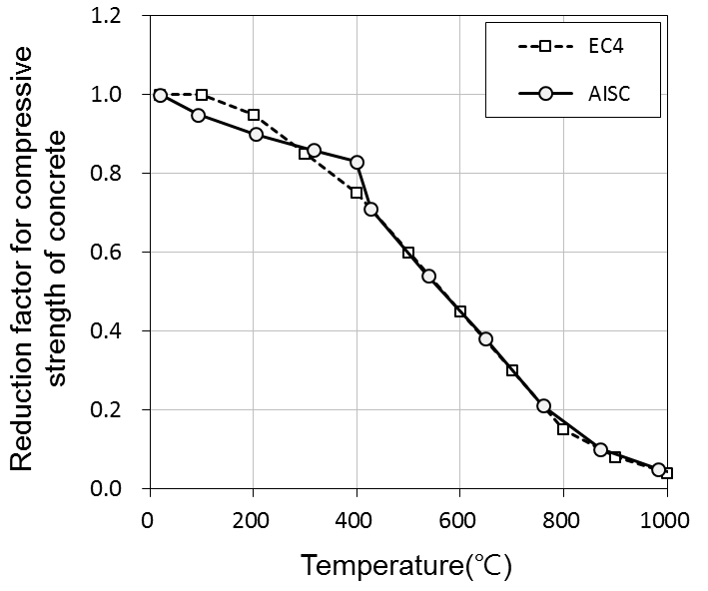
Structural Fire Design in Codes and Standards
Thermal and mechanical properties of materials
Thermal properties
Thermal elongation
Specific heat
Thermal conductivity
Density
Mechanical properties
Stress-strain relationship: Effective yield strength, Slope of the linear elastic range, Proportional limit

Slide 23
Structural Fire Design in Codes and Standards
Simple calculation method in EUROCODE
Eurocode 2: Design of concrete structures - Part 1-2: General rules - Structural fire design
Two simplified methods using a reduced cross-section
applicable to structures subjected to a standard fire exposure
500°C isothermal method
concrete at a temperature more than 500°C is neglected in the calculation of load-bearing capacity
concrete at a temperature below 500 °C is assumed to retain its full strength.
Zone method
the fire damaged cross-section is reduced by ignoring a damaged zone at the fire-exposed surfaces.

Slide 24
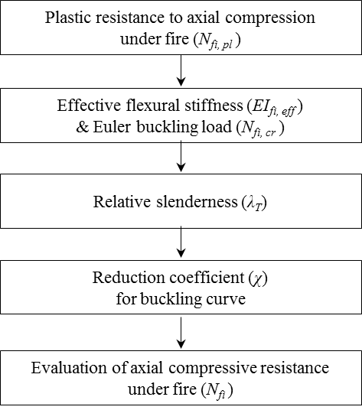
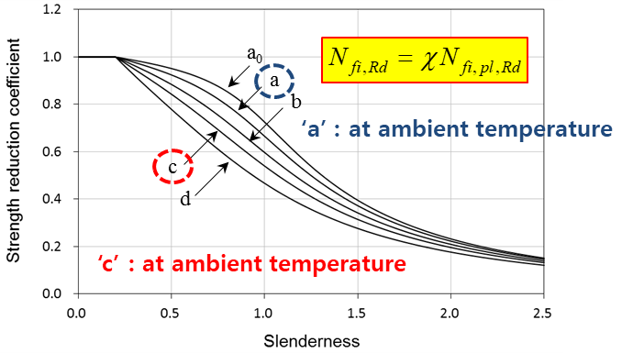
Structural Fire Design in Codes and Standards
Simple calculation method in EUROCODE
Eurocode 3: Design of steel structures - Part 1-2: General rules - Structural fire design
Simplified methods modifying the design resistance for normal temperature design
usually used the hypothesis of a uniform temperature in the cross-section
Eurocode 4: Design of composite steel and concrete structures - Part 1-2: General rules - Structural fire design
Simplified methods considering composite effects of steel and concrete
Detailed procedure of simple calculation for composite column

Slide 25
Advanced Structural Fire Design
Performance-based design
Disadvantages of prescriptive approach
Actual structural behavior & Real fire effect are ignored.
Levels-of-safety and robustness are unknown.
Optimum solution for life safety, economical impact and environmental damage are unknown.
Many countries are moving towards performance-based codes which
Sate how a building is to perform under a wide range of conditions
Use of calculation/engineering methods
Allow actual behavior and robustness of the building to be assessed
Allow designers to use alternate fire safety strategies, provided adequate safety can be demonstrated
Allow optimum design solution taking into account life safety, financial impact and environmental issues
can be used to justify cost-effective solutions
Can be used as part of an assessment of multiple risks
Within a prescriptive code, there may be possibility to allow for performance-based selection of structural assemblies
if a code specifies a floor with a fire resistance rating, designers have the flexibility to select from a range of listed systems which have sufficient fire resistance
However, Standard calculation methods have not yet been developed for widespread use

Slide 26
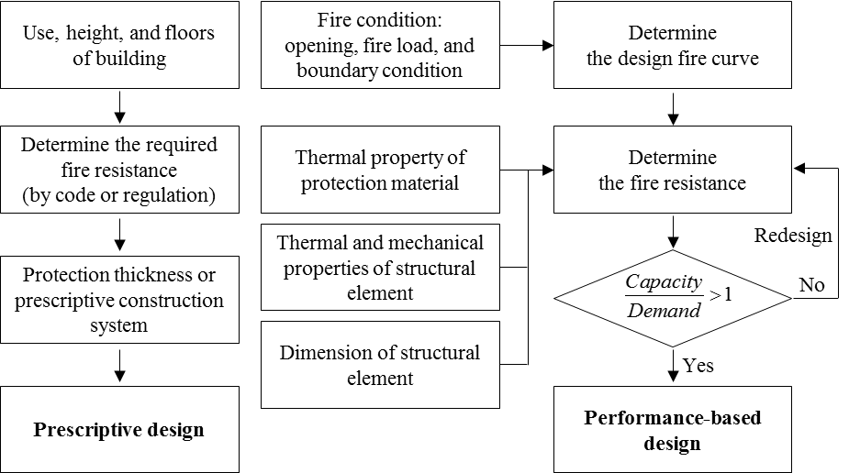
Advanced Structural Fire Design
Performance-based design
In developing new codes, many countries have adopted a multi-level code format in the form of:
overall goals, functional objectives and required performance which must be achieved
selection of alternative means of achieving those goals. The three most common options are:
to comply with a prescriptive 'Acceptable Solution'
to comply with an approved standard calculation method
to perform a performance-based fire engineering design from first principles
So, compliance with performance-based codes is usually achieved by:
Mainly satisfying the requirements of acceptable solutions, or
Carrying out a performance-based alternative design based on fire engineering principles
Under a performance-based design, it is essential to have comprehensive documentation & quality control
The calculations should be included in a report which describes the building & the complete fire design process

Slide 27
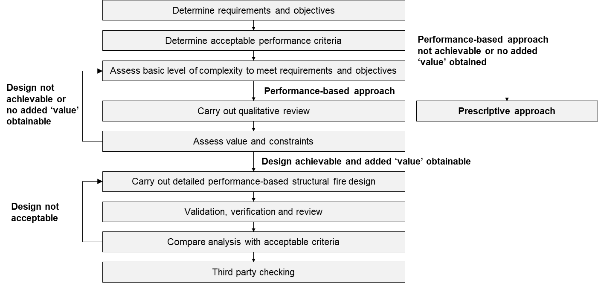
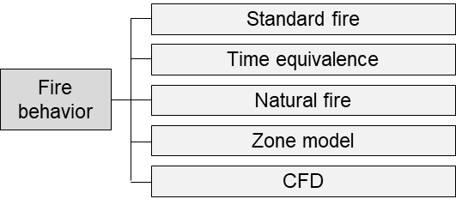
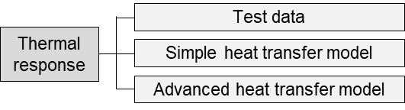
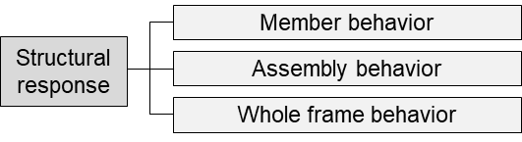
Advanced Structural Fire Design
Performance-based design process
Three components of structural fire engineering design

Slide 28
Advanced Structural Fire Design
Assessment methods for thermal exposure
Assessment Method | Model for thermal Exposure | Description
Level 1 | H1 | Standard fire exposure – test or tabulated data
Level 2 | H2 | Equivalent fire duration time – relates the severity of a compartment fire to an equivalent period in a standard furnace
Level 3 | H3 | Parametric exposure – uses physical characteristics of the fire compartment as input parameters
Level 4 | H4 | Advanced methods – zone or field models used to characterize the full compartment response for the required duration

Slide 29
Advanced Structural Fire Design
Options for estimating the heat transfer
Model | Design charts/test data | Simple formulae | Advanced models
Complexity | Simple | Intermediate | Advanced
Analysis ability | Exact solution Standard fire condition | Empirical solution Standard fire condition | Accurate solution Any fire condition
Member types | Dependent on available test data | Mainly steel members | Any material and construction methods
Input parameters | Construction type & Member geometry | Heat flux or fire curves, Boundary conditions, Member geometry, Material thermal properties
Solutions | Cross-sectional temperature charts Tabulated thermal data | Simple cross-sectional temperature profile | One to three-dimensional time and space dependent temperature profile
Design tools | Fire part of Eurocodes Test/Research reports | Fire part of Eurocodes Design guides | Finite element package
 | Design charts/tables | Spreadsheet | Computer models

Slide 30
Advanced Structural Fire Design
Options for Structural Analysis
Model | Design charts/test data | Simple formulae | Advanced models
Complexity | Simple | Intermediate | Advanced
Input parameters | Temperature through the cross-section Material strength and stiffness reduction Applied static load Simplified boundary conditions | Temperature through the cross-section and along the member Material strength and stiffness reduction Applied static load Boundary conditions | Temperature through and along the cross- section Full material stress-strain- temperature relationship Applied static load Boundary conditions Element type and density
accuracy | Ignores real behaviour but assumed to be conservative Ultimate strength calculation | Begins to consider actual load paths and restraint Ultimate strength calculation | Predicts internal stresses, displacements, and rotations for all members throughout the duration of the fire Localized behavior is not modelled accurately in whole building modelling
design tools | Simple equations for hand calculations | Simple equations for hand calculations Plastic design, redistribution of moments Simple computer models | Commercially available or purpose written computer software

Slide 31
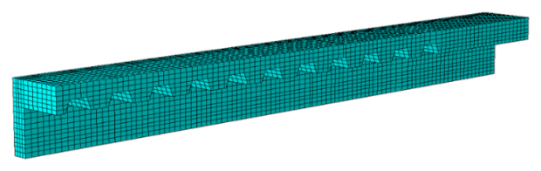
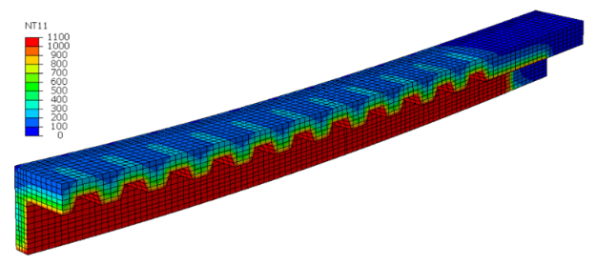
Advanced Structural Fire Design
Whole building behavior and the use of advanced models
Purpose-written or commercially available finite element software can be used to assess the structural response under fire conditions
Structural fire engineers should be adequately experienced to identify the assumptions and approximations embedded within the software including its limitations.

Slide 32
Summary
Structural Fire Engineering
Fire is one of the severe disasters that cause a great loss of life and property.
Purkiss (2007) :
“The application of scientific and engineering principles to the effects of fire in order to reduce the loss of life and damage to property by quantifying the risks and hazards involved and provide an optional solution to the application of preventive or protective measure.”
Structural Fire Design in Codes and Standards
Assessment methods of fire resistance in time, temperature, and strength domains
Fire-resistance rating requirements for building elements based on construction type and occupancy
Reviewed the prescriptive method and calculation method in IBC
Also reviewed the simple calculation method in EUROCODE 2/3/4
Advanced Structural Fire Design
Drawbacks of the current design method based on the prescriptive approach
Process of performance-based structural fire design
Reviewed the options for heat transfer and structural analysis
Possibility of structural assembly and whole building behavior analysis using advanced models

Slide 33
References
Codes & Standards
ACI 216.M-07, Standard Method for Determining Fire Resistance of Concrete and Masonry Construction Assemblies
AISC 360-16, Specification for Structural Steel Building
ASCE/SFPE 29-05, Standard Calculation Methods for Structural Fire Protection
Eurocode 1, Actions on Structures, Part 1.2: General Actions - Actions on Structures Exposed to Fire
Eurocode 2, Design of Concrete Structures, Part 1.2: General Rules-Structural Fire Design
Eurocode 3, Design of Steel Structures, Part 1.2: General Rules-Structural Fire Design
Eurocode 4, Design of Composite Steel and Concrete Structures, Part 1.2: General Rules-Structural Fire Design
International Building Code
ISO 834-1: Fire Resistance Test–Elements of Building Construction
NFPA 5000, Building Construction and Safety Code
Books
Andrew H. Buchanan, Structural Design for Fire Safety
IStrucE, Guide to the advanced fire safety engineering of structures
SFPE Handbook of Fire Protection Engineering
Y.C. Wang, Steel and Composite Structures: Behavior and Design for Fire Safety

